Slide 1
Volcano
Orchestrating the full AI lifecycle
From Training to Inference and Agents
Zicong Chen (Huawei Technologies)
Máté Hajnal (Aumovio)
Notes:
Hi everyone, thanks for joining us on the Maintainer’s track. We will speak about Volcano how it’s orchestrating the full AI lifecycle, Our focus here won’t be just one product in isolation. It is the full lifecycle from training, inference, and now highly bursty agent sessions.

Slide 2


Orchestrating the full AI lifecycle
From Training to Inference and Agents
Zicong Chen R&D Engineer, Volcano Maintainer Huawei Technologies Co., Ltd
https://github.com/JesseStutler
Máté Hajnal Senior MLOps Engineer, Volcano Core Contributor
Aumovio SE.
https://github.com/hajnalmt
Notes:
Before we start, a quick speaker intro. Let us introduce ourselves. My colleague here is Chen Zicong an R&D Engineer, Volcano Maintainer from Huawei Technologies. I am Máté Hajnal a Senior Machine Learning Operations Engineer at Aumovio, a Volcano Core Contributor.
Let's move to Agenda.
Timing: 00:00-00:30

Slide 3
Agenda
Big Picture - From Batch System To A Unified Scheduling Platform
Scalable and Efficient Foundation - A robust core for ALL workloads (Microservices, Batch, AI, HPC) at ultra-large scale.
What’s new in Volcano Network Topology Aware Scheduling
Kthena - Enterprise-Grade LLM Serving
AgentCube - Cloud-Native Agent and Code Interpreter Platform
Volcano Global - Multi-Cluster Federation and Roadmap
Notes:
Here it is. I will cover the Big Picture, the Volcano evolution. I will try to guide you into the Scalable and Efficient Foundation we laid down in the project, how it serves as a robust core for ALL workloads (Microservices, Batch, AI, HPC) at ultra-large scale. After the extended topology-aware section comes, where I will cover the latest features in Volcano Network Topology Aware Scheduling; Chen will continue with Kthena an Enterprise-Grade LLM Serving Platform, AgentCube which is the Cloud-Native Agent and Code Interpreter Platform and Volcano-Global the component that’s capable of multi-cluster federation.
Timing: 00:30-01:25

Slide 4
From Batch System To A Unified Scheduling Platform
Notes:
Volcano evolved from the kube-batch project, it was developed throughout the years from being a standard batch system to be a general unified scheduling platform. Just a little history, it became part of CNCF-Volcano was accepted to CNCF on April 9, 2020 and moved to the Incubating maturity level on March 21, 2022. In 2026 we look forward to become a CNCF Graduated project.
Timing: 01:25-02:00

Slide 5



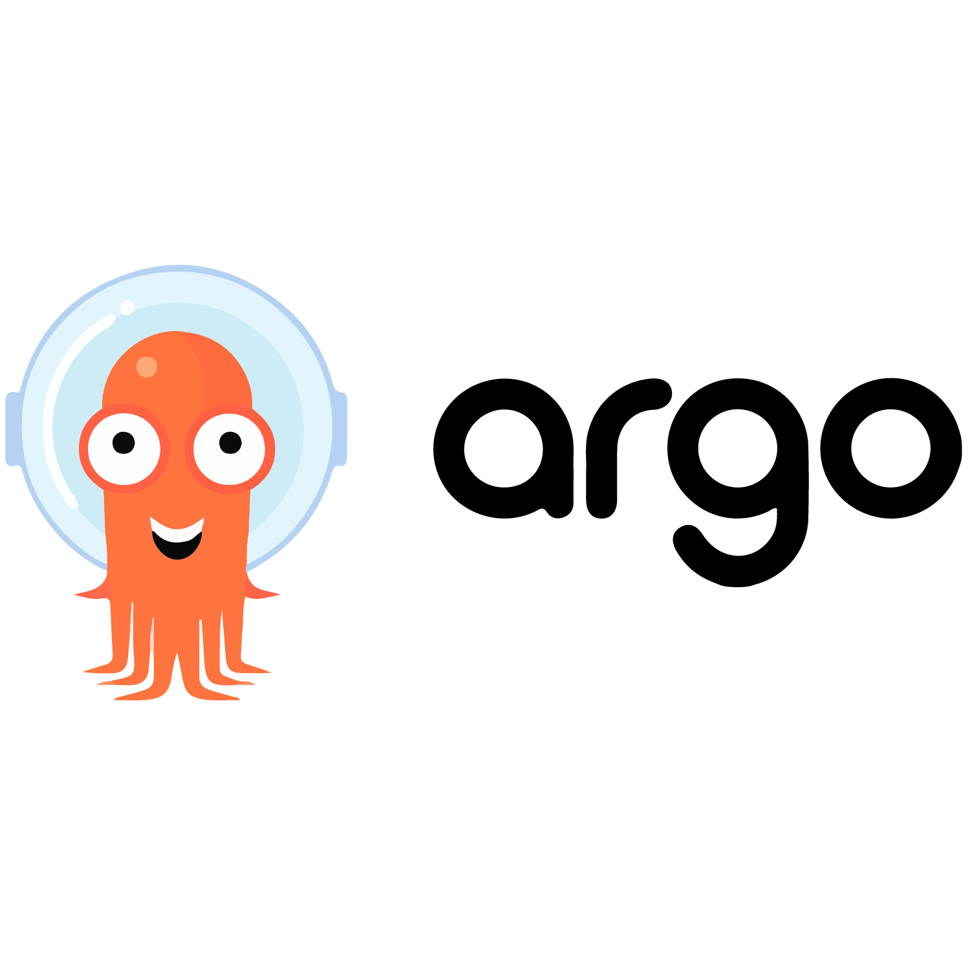
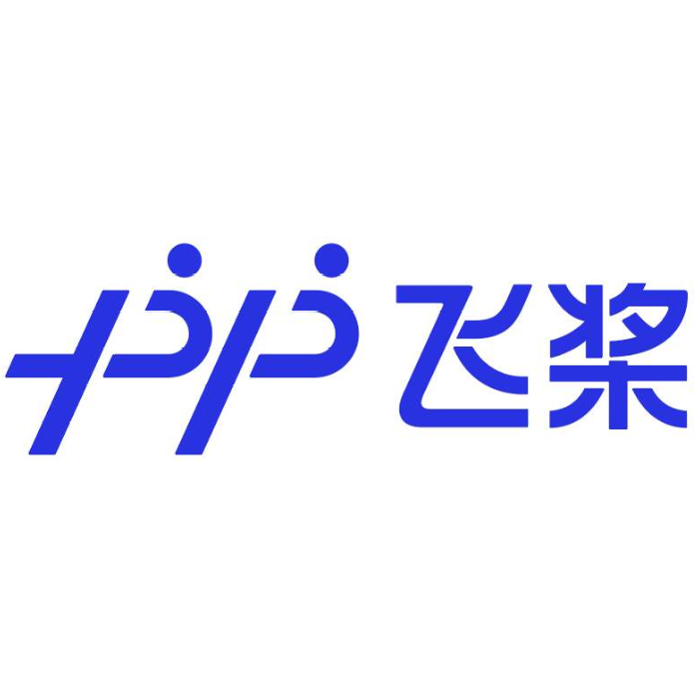
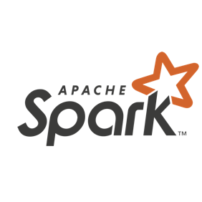
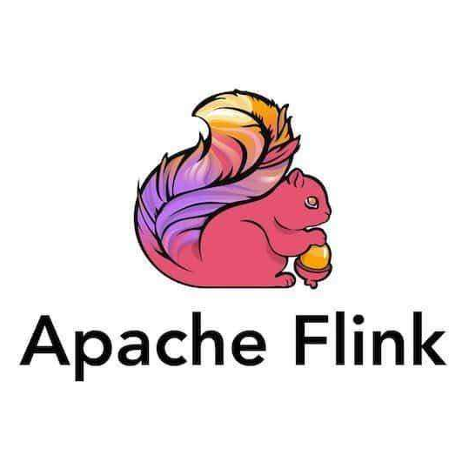



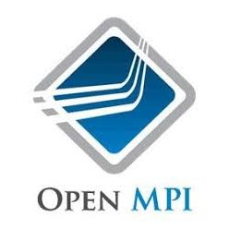


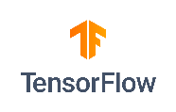
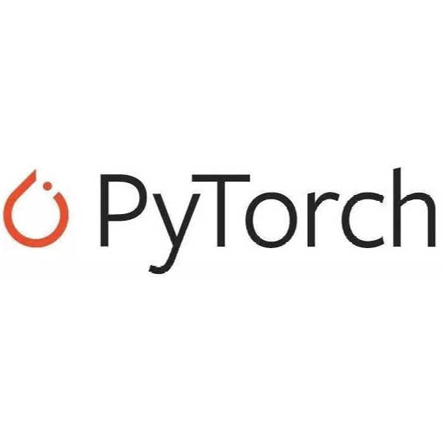
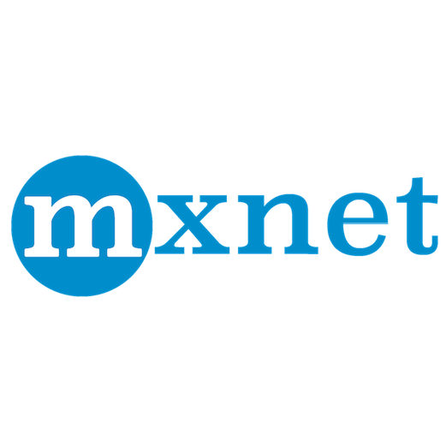



Volcano Overview
AI
MicroService
Unified Scheduling
Supports integrated job scheduling for both Kubernetes native workloads and mainstream computing frameworks (such as TensorFlow, Spark, PyTorch, Ray, Flink, etc.).
Queue Management
Provides multi-level queue management capabilities, enabling fine-grained resource quota control and task priority scheduling.
Big Data
HPC
Transcoding
AI
AI
AI
B
B
B
H
H
H
T
T
T
M
M
M
Batch Computing
MicroService
Workloads Colocation
Enables online and offline workloads colocation, improving cluster resource utilization through intelligent scheduling strategies.
Multi-cluster Scheduling
Supports cross cluster job scheduling, improving resource pool management capabilities and achieving large scale load balancing.
Volcano Global
Cluster A
Cluster B
Heterogeneous Device Support
Efficiently schedules heterogeneous devices like GPU and NPU, fully unleashing hardware computing potential.
Multiple Scheduling Policies
Supports various scheduling strategies such as Gang scheduling, Network Topology Aware Scheduling, Fair-Share, Binpack, DeviceShare, NUMA-aware scheduling, Task Topology, etc.
Node
AI
AI
T
Node
AI
B
M
T
M
H
H
kubelet
Volcano Agent
Kubelet
Volcano Agent
Notes:
Some of listeners may already be familiar with the Volcano project, while others may not. So let's take a quick look at the Volcano overview. Volcano originated from kube-batch and has been working as a cloud-native batch system. Now it’s a Unified Scheduling platform supporting wide variety of native workloads and frameworks. It provides advanced multi-level queue management for resource quota control, and priority scheduling. With Volcano Agent it enables workloads colocation for online-offline workloads through intelligent scheduling strategies. With volcano-global it supports cross cluster Job scheduling and by design it supports heterogeneous devices like GPUs and NPUs or other accelerators. By adding multiple scheduling policies to the picture like Gang-, Network Topology Aware- Scheduling, Fair-Share, Binpack, DeviceShare, NUMA-aware- or Task Topology scheduling) I think we can truly say that Volcano is more than a simple scheduler, it is Unified Scheduling Platform.
Timing: 02:00-02:50 Old note: It also perform queue management and gang scheduling, and has rich ecosystem and can support heterogeneous accelerators.

Slide 6
Why now: the workload drift
AI workloads are diverging fast.
Batch training dominated cluster design
Massive LLM
Distributed Training
LLM serving introduced disaggregated runtime patterns
Agent workloads
Bursty, short-lived, ultra-low latency scheduling
~ 2018
~ 2023
~ 2025
~ 2025
New requirement: one control plane, multiple execution patterns
One platform shall optimize for throughput and latency together
Notes:
The first message is simple: AI workloads are diverging fast.
A few years ago, most clusters were dominated by batch-style training.
In 2023, more and more LLMs were emerging, and LLM training was experiencing explosive growth.
Now we also run disaggregated LLM serving, where prefill and decode have very different runtime behavior.
With the surge in popularity of LLM serving in 2025, agent workloads have also increased, where sessions are short-lived, latency-sensitive, and extremely bursty.
Different workload characteristics pose challenges to the scheduler, Volcano has been widely used in AI training since its incubation, so Volcano will continue to evolve, including the support of LLM inference and Agent Workloads, while maintaining the support of existing workloads to become a unified scheduling platform

Slide 7






















Volcano Technical Roadmap for 2026 and Beyond
Observability & Ops
AI Training & RL
Distributed Inference
AI Agent
Big Data & HPC
Ops & Tooling
Application & Workload Ecosystem
Distributed Training, Fine-tuning, RLHF
PD-disaggregated Inference
Agent Workflow & RAG
Batch / Scientific Computing
Megatron | DeepSpeed | veRL | AReaL
vLLM | SGLang | MindIE | TensorRT
LangGraph | Dify | A2A
Spark | Flink | Horovod | Ray
Observability
Job Metrics, Tracing, Dashboard, Resource Heatmap
Workloads & Job Orchestration
HyperJob
Kthena
AgentCube
VolcanoJob
LLM Training Parallelism
Elastic Inference Service
Multi-Agent Orchestration
Unified Job Abstraction
Model/Parameter/Data/ Parallelism
PD Disaggregation / Large EP
Hibernate/Resume / Fast-Startup
Batch / MPI / Pytorch / TF …
CLI & SDK
Volcano CLI, JobFlow SDK, Python Client
Multi-tenant Resource Sharing
High Throughput Scheduling
Multi-cloud & Federation
Hierarchical Queue Management
SLO-aware Preemption
Dynamic Resource Oversubscription
Gang Scheduling / Binpack
Fair Scheduling (FairShare / DRF)
AI Topology Awareness (All-Reduce Opt)
Multi-cluster Job Orchestration
Adaptive Decomposition for Hyper-scale Training
Cross-domain Resource Sharing & Training Over Heterogeneous Clusters
Ecosystem Integration
Kubeflow, Spark/Flink Operator, Argo Workflow, Kserve, AIBrix, LLM-D, AgentSandbox and more...
Volcano Core Scheduler
Unified High-Performance Scheduling Framework
Unified high-throughput scheduling for Microservices, Batch, Distributed Inference, AI Agents, Serverless workloads, etc.
Resource Management
Heterogeneous Pool
Topology Abstraction
Device Access
Fine-grained GPU/NPU Sharing & Isolation
Intra-node / Inter-node (HyperNode) Topology
Device Plugin | DRA | NRI | CDI
Infrastructure & Runtime
Sandboxer
OS (Colocation)
Hardware
Kuasar | Kata | WASM | gVisor Firecracker | CloudHypervisor
openEuler | SUSE | Ubuntu | RHEL | more…
CPU / GPU / NPU / TPU
RoCE / InfiniBand / FPGA
Notes:
This leads to Volcano Technical Roadmap for 2026 and Beyond. From the top level, not just VCjob, Volcano will support more native workloads to support massive LLM training, LLM inference, and agent workloads. Collaborate with more other communities, such as reinforcement learning areas, inference frameworks, agent frameworks.
At the bottom, Volcano will support more heterogeneous devices as a unified heterogeneous device allocation pool and support more features in network topology-aware scheduling to improve AI workload performance

Slide 8
Scalable and Efficient Foundation
Notes:
This brings to the scalable an efficient foundation we built

Slide 9
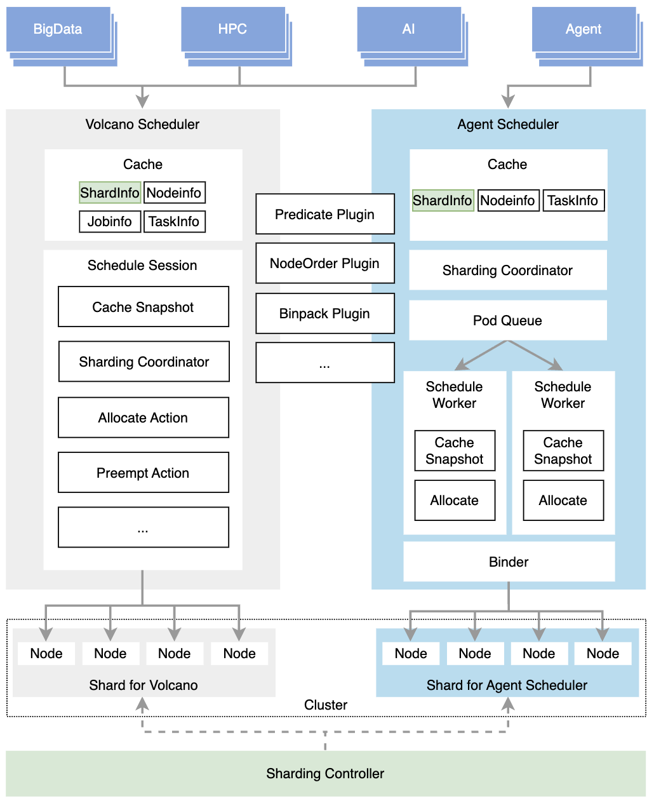
Agent scheduler: Fast Scheduling for AI Agent Workloads
Dedicated fast scheduling path for latency-sensitive workloads (e.g. agent workloads)
Multi-worker parallel scheduling
Optimistic concurrency + conflict-aware binding
Optimized Scheduling Queue: Enhanced queue mechanism with urgent retry support
Seamless coordination with Volcano batch scheduler via Sharding Controller
Notes:
In v1.14, we introduced agent scheduler, as we know, volcano existing batch scheduler has outstanding performance in gang scheduling, However, the session mechanism schedules every second by default, which cannot meet the need bursty, latency-sensitive workloads of agent workloads.
Agent Scheduler provides a dedicated fast path for latency-sensitive workloads such as AI agents and serverless-like traffic.
The design includes multi-worker parallel scheduling, optimistic concurrency control, and conflict-aware binding, and it can seamless coordination with volcano batch scheduler.
But follows the pluggable design of the Volcano Scheduler, leveraging plugins like the predicate, the nodeorder and the binpack: Keep scheduling strategy pluggable and reuse part of Volcano scheduler Plugins to apply scheduling strategy
Predicate plugin: Predicate plugin provides basic checking for Pod allocation on Pod, like affinity, TaintToleration, etc. Agent workload may not care about Pod interpod Affinity or Spread strategy. These strategies are streamlined or removed from the plugin to further improve scheduling efficiency.
NodeOrder plugin: The NodeOrder Plugin scores nodes from various dimensions to find the node that is best suited for the current job.
Binpack plugin: The scheduling algorithm is to fill as many existing nodes as possible
Nodes Selection:
Schedulers can select nodes based on either hard isolation or soft isolation between shards.
Hard Isolation: Workloads can only be scheduled onto nodes within the scheduler’s assigned shard
Pro: No scheduling conflicts occur between schedulers, each scheduler only needs to perform scheduling calculations within its shard.
Con: Lack a global cluster view, Scheduling may fail if local resources within a shard are insufficient, potentially reducing overall cluster resource utilization
Soft isolation: The scheduling algorithm is to fill as many existing nodes as possible
Pro: Global cluster view, improved cluster resource utilization
Con: Under high resource pressure, scheduling conflicts between schedulers may occur, affecting scheduling efficiency. Additionally, maintaining a global view increases scheduling computation cost.
Most importantly, it is integrated with sharding coordination, so we preserve platform-level consistency while improving p99 startup latency for short-lifecycle workloads.
A designed system where, batch fairness and low-latency agent scheduling can coexist in one platform.

Slide 10
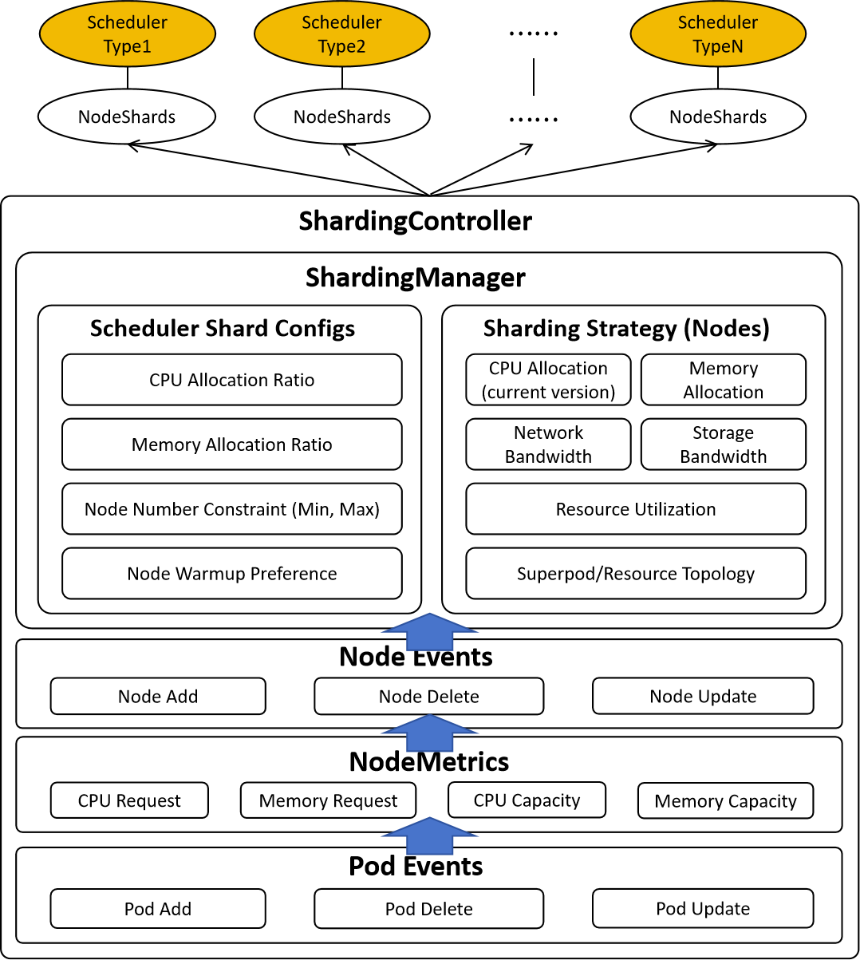
Scalable Multi-Scheduler with Dynamic Node Scheduling Shard
Specialized Scheduling, Resource Optimization
Scalability, Workload Isolation
Sharding Controller dynamically computes node pools based on extensible policies rather than inefficient static hard partitioning.
Enables flexible scheduler combinations (e.g., multiple Batch Schedulers, or Agent + Batch) coordinating via the NodeShard CRD.
Notes:
As a unified scheduling platform, volcano needs to schedule AI agent workloads and existing batch workloads at the same time, so it needs to have a dynamic sharding mechanism to allow multiple schedulers to collaborate in the cluster, and at the same time, multiple batch schedulers can also improve the existing volcano scheduling throughput.
In v1.14, Dynamic Node Sharding introduces a Sharding Controller that computes candidate node pools per scheduler dynamically.
The Sharding Controller is proposed to addresses these challenges by:
- **Specialized Scheduling**: Enabling dedicated schedulers for different workload types (Agentic AI vs traditional batch)
- **Resource Optimization**: Dynamically partitioning cluster resources based on allocation/utilization patterns; Different workload schedulers have different resource specifications according to the utilization patterns of corresponding workloads
- **Scalability**: Decoupling the resource supply from the resource scheduling; The sharding controller is responsible for dynamically partitioning the cluster resource into different shards according to schedulers' specifications of resource requirements. Finally, it assigns the partitioned resource shards (a group of nodes) to each scheduler. The schedulers can then schedule tasks on selected nodes, thus eliminating the single scheduler bottleneck for large clusters;
- **Workload Isolation**: Preventing resource contention between different workload types; Each scheduler's shard has no shared nodes with other shards, thus avoid scheduling conflicts of different schedulers in the cluster;
Operationally, this lets Batch and Agent schedulers coexist and coordinate safely, instead of overloading one global scheduling path with conflicting optimization goals.

Slide 11
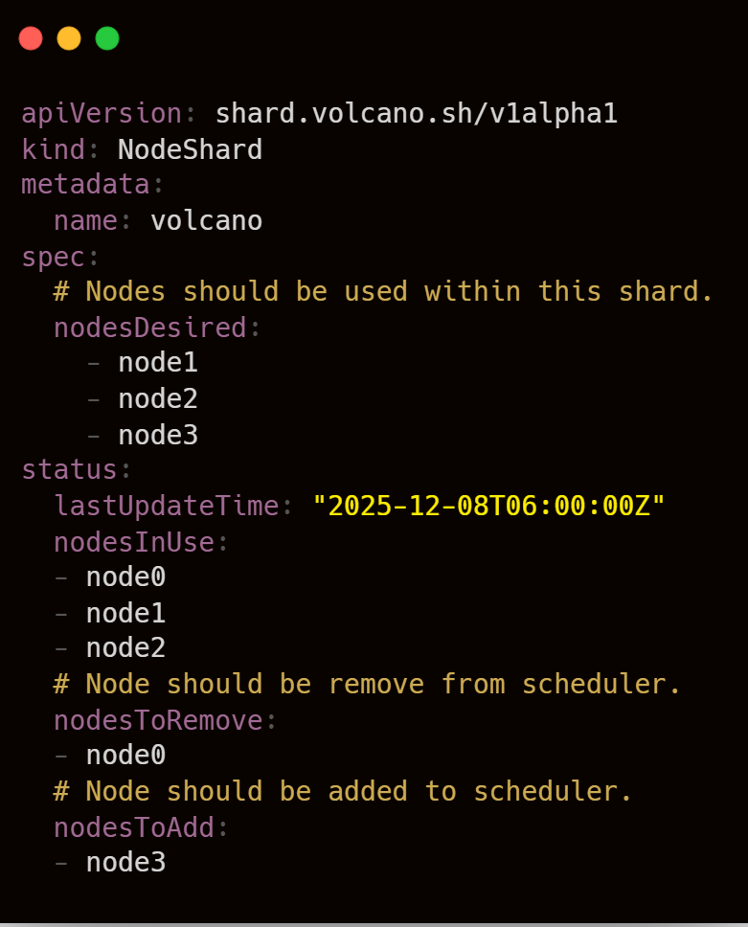
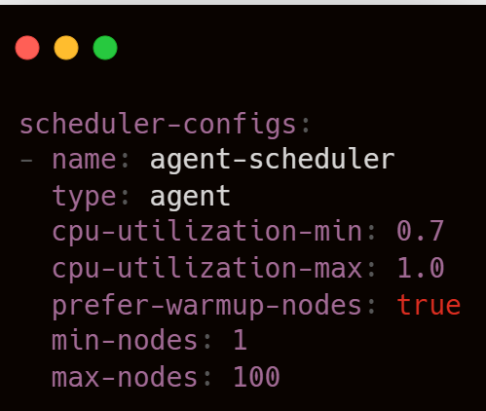
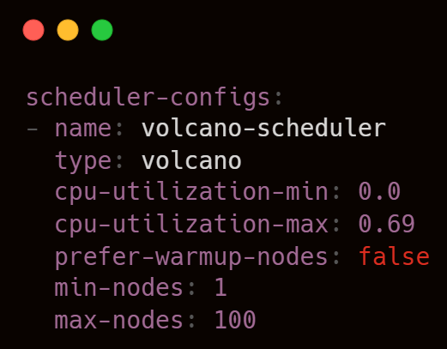
NodeShard CRD
NodeShard CRD becomes the coordination contract
Dynamic Candidate Node Pools: Replaces static hard-partitioning with dynamic node pools, improving cluster utilization.
Pluggable Sharding Strategies: Extensible policy design to compute candidate nodes (e.g., CPU utilization strategy available now).
Node Shard Example
Sharding Configuration
Notes:
The NodeShard CRD becomes the contract.
This means shard assignment is no longer static infrastructure partitioning; it adapts to cluster state and strategy.
Today one implemented strategy is CPU utilization based assignment, and the architecture is explicitly pluggable for additional strategies.
Operationally, this lets Batch and Agent schedulers coexist and coordinate safely, instead of overloading one global scheduling path with conflicting optimization goals.

Slide 12
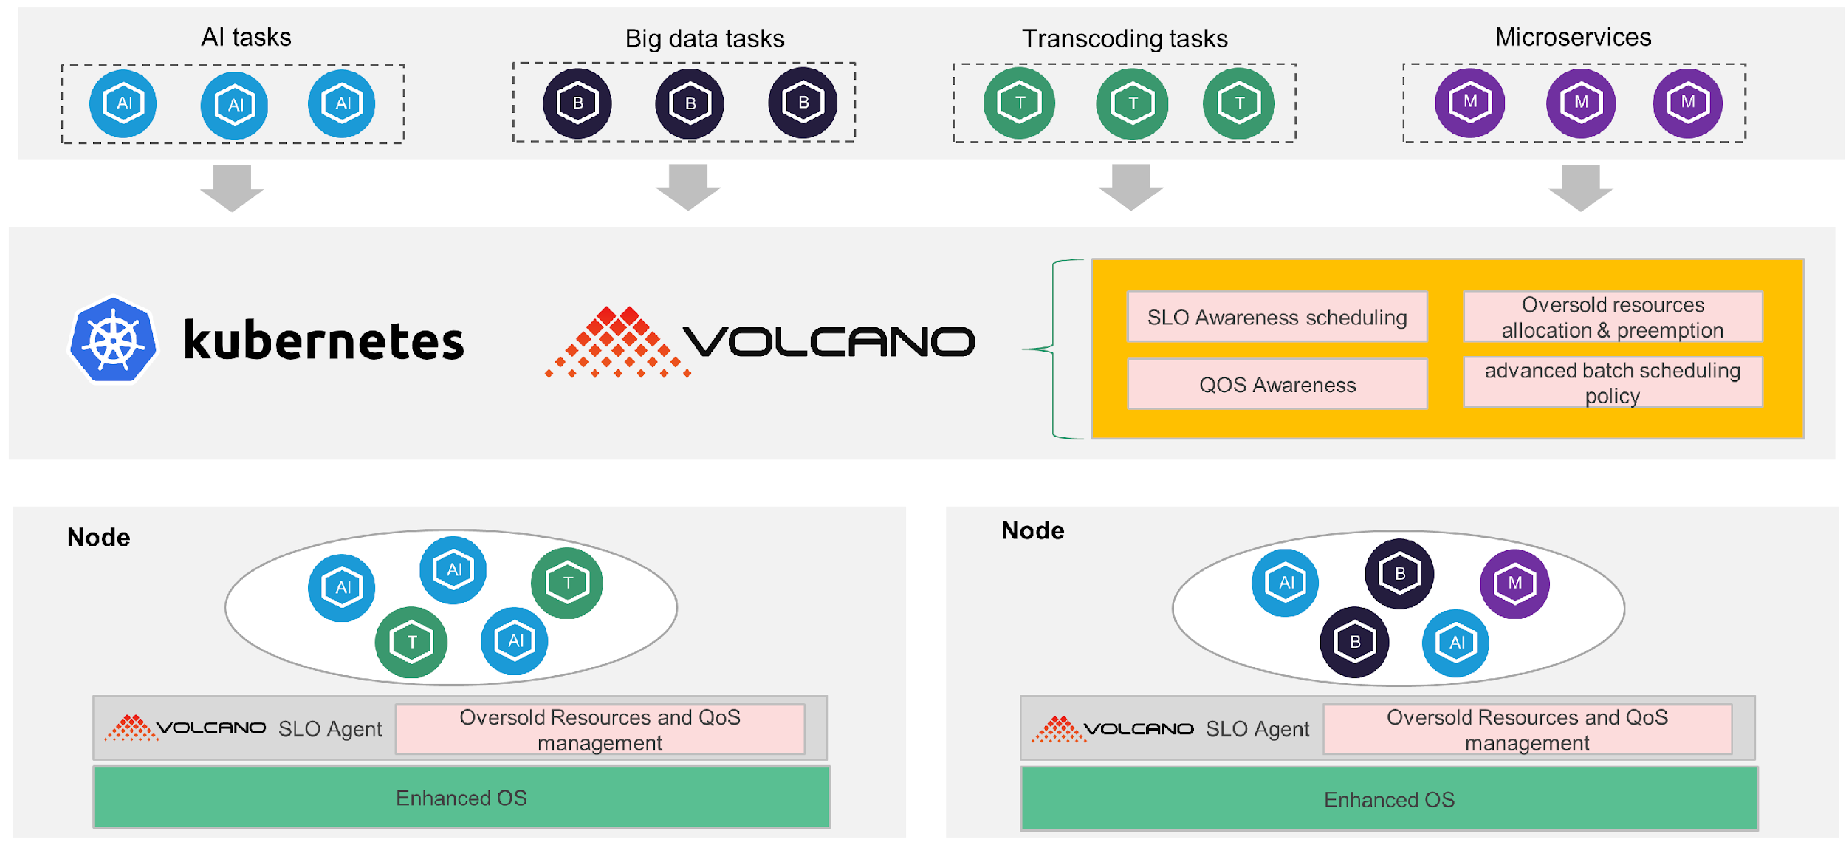
What’s new in Volcano Colocation
Different QoS Model:
LC (Latency Critical)
HLS (Highly Latency Sensitive)
LS (Latency Sensitive)
BE (Best Effort)
Multi-Workload support
Microservices | AI | Big Data | HPC
Comprehensive QoS guarantees
Protects online services by suppressing or evicting offline jobs during resource contention
Dynamic Oversubscription
+30% utilization via real-time reclaim
CPU Burst
Allow to temporarily exceed CPU limits
Online
Offline
Notes:
Volcano's colocation solution significantly improves cluster resource utilization by running online and offline workloads together, while ensuring the Service Level Objectives (SLOs) of high-priority online services. It is non-intrusive to Kubernetes and provides fine-grained, OS-level resource isolation and QoS guarantees.
QoS-Based Colocation Model: Defines different QoS levels (e.g., LC, HLS, LS, BE) for various workloads, mapping them to different CPU and memory priorities at the kernel level to ensure high-priority tasks get resource preference.
Unified Scheduling: Uses a single Volcano scheduler to manage both online and offline workloads, avoiding resource conflicts that can arise from multiple schedulers.
Dynamic Resource Oversubscription: Dynamically calculates and reclaims unused resources (allocated but not used) from online services and makes them available to offline workloads, increasing pod density and overall utilization.
Comprehensive QoS Guarantees: Provides multi-dimensional resource isolation at the OS level for CPU, memory, and network. It suppresses offline workloads' resource usage during contention to protect online services, and evicts offline jobs under high node pressure.
CPU Burst: Allows containers to temporarily exceed their CPU limits by using accumulated, unused CPU quotas from previous periods. This helps reduce CPU throttling and lowers the tail latency of sensitive applications.

Slide 13
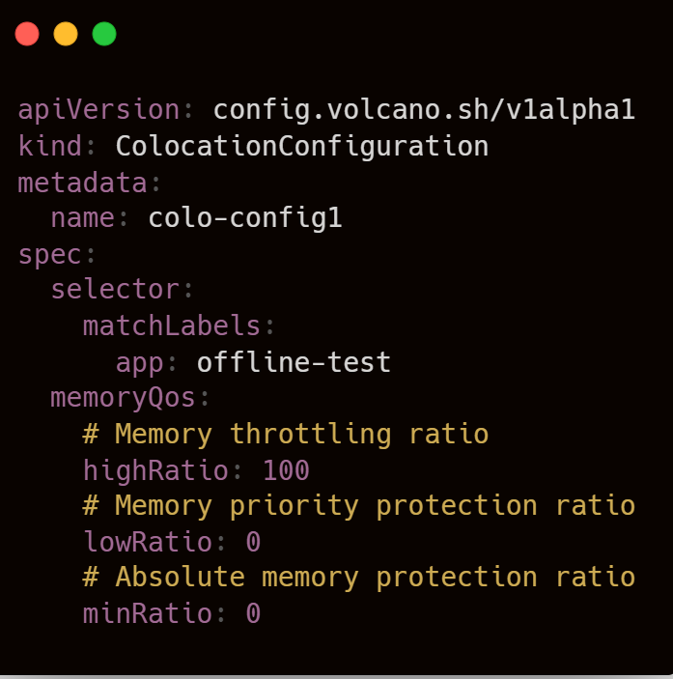
What’s new in Volcano Colocation
Expanded OS Support: Fully decoupled from specific distros, now supporting generic operating systems (Ubuntu, CentOS, etc.).
Dynamic CPU Throttling & Burst: Adaptive CPU quota adjustment for offline pods to protect online workloads, plus CPU Burst for latency-sensitive tasks.
Full Cgroup v2 Integration: Auto-detects cgroup versions and natively implements v2 resource managers.
Fine-grained Memory QoS
Declarative Policy API: Introduced ColocationConfiguration CRD
Notes:
In v1.14, Volcano Colocation expanded a lot of capabilities.

Slide 14
Volcano Topology Aware Scheduling: What’s new?

Slide 15
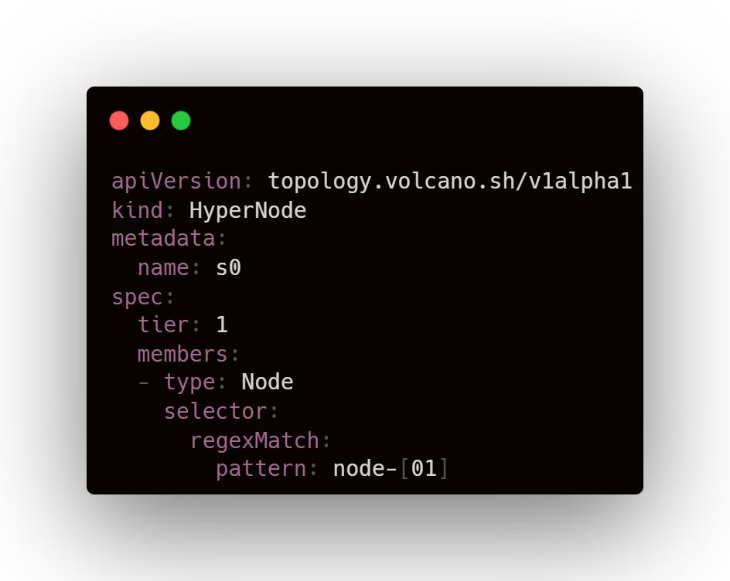
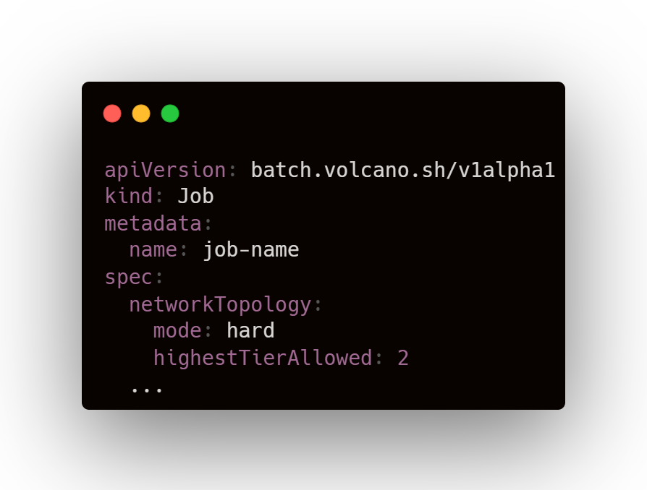
Volcano Topology Aware Scheduling
Large-scale AI clusters lack unified topology abstraction, requiring optimized intra- and inter-node configurations for maximum performance
v1.12: HyperNode-based topology-aware scheduling reaches alpha
v1.13: label-based HyperNode auto-discovery added
v1.14: richer subgroup-level constraints and gang coordination; HyperNode-level binpacking reduces fragmentation
Non-Leaf HyperNodes (s4, s5, s6):
Represent other HyperNodes.
Leaf HyperNodes (Node[01]):
Whose members are actual cluster nodes.
Standardizing Cluster Topologies via Performance Domains
S6
Switch 2
S4
S5
Switch 1
S0
S1
S2
S3
Switch 0
Leaf: Actual Nodes
Node0
Node1
Node2
Node3
Node4
Node5
Node6
Node7
Notes:
Let's review Volcano Network Topology Aware Scheduling, which some of you may have already encountered or used.
What we saw is that Large-scale AI clusters lack unified topology abstraction, which is required for optimized intra- and inter-node configurations for maximum performance.
This is how HyperNodes were born, which with topology is no longer metadata decoration, it is a first-class scheduling primitive.
Compare to some schedulers used node labels to specify topologies, we believe that hypernode is the best abstraction to represent the network topology domain with the same performance, and it is also the API that is currently very needed for AI training and inference world.
Having an entity like HyperNode can represent more network networking architectures, not just spine-leaf architectures, and can do health monitoring, network congestion monitoring, and hypernode-level scheduling strategies

Slide 16
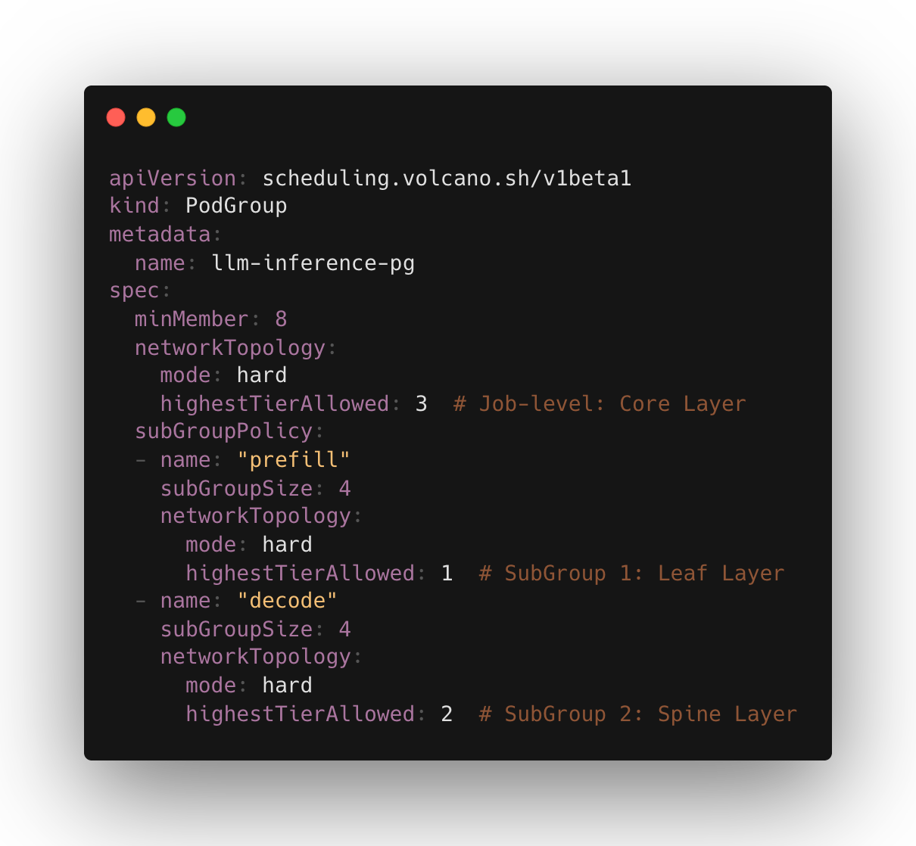
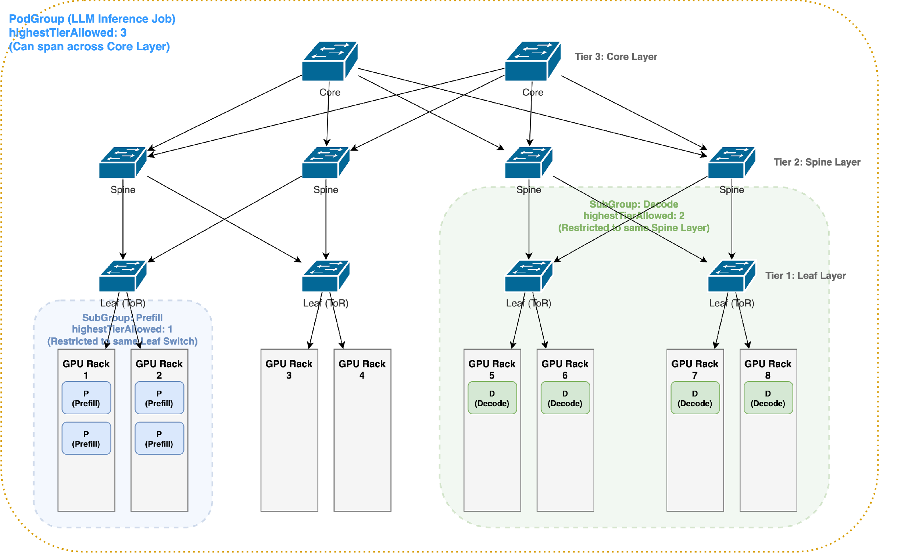
Multi-Level Network Topology Scheduling
PodGroup
(highestTierAllowed: 3 minMember:8)
SubGroup-prefill
(highestTierAllowed: 1 minMember:4)
SubGroup-Decode
(highestTierAllowed: 2 minMember:4)
Notes:
Prefill: Processes the entire sequence in parallel and store key and value vectors from the attention layers in a KV cache. Because it’s handling all the tokens at once, prefill is compute-bound, but not too demanding on GPU memory.
Decode: Generates the output tokens, one at a time, by reusing the KV cache built earlier. Different from prefill, decode requires fast memory access but lower compute. Since prefill primarily determines the TTFT (Time to First Token) and decode impacts ITL (Inter Token Latency), collocating them makes it difficult to optimize both metrics simultaneously.

Slide 17

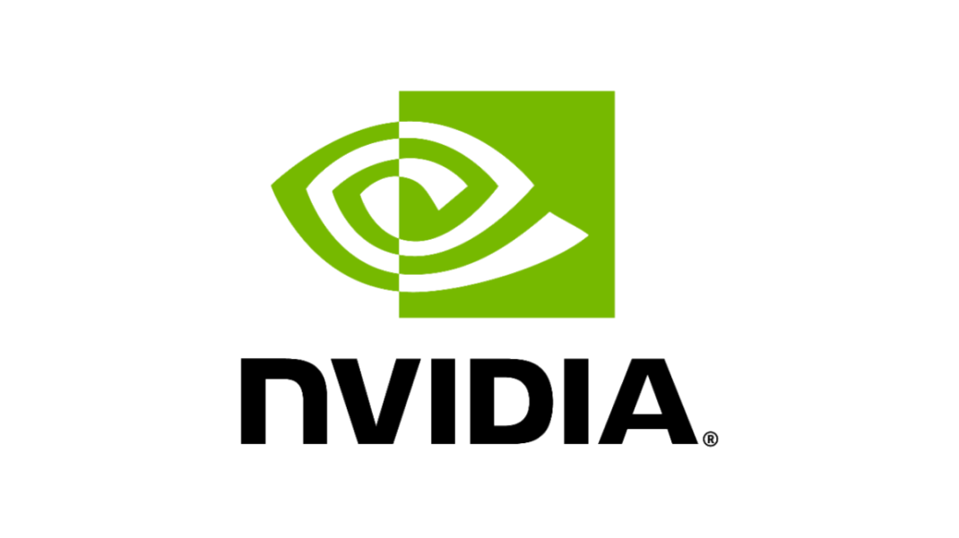

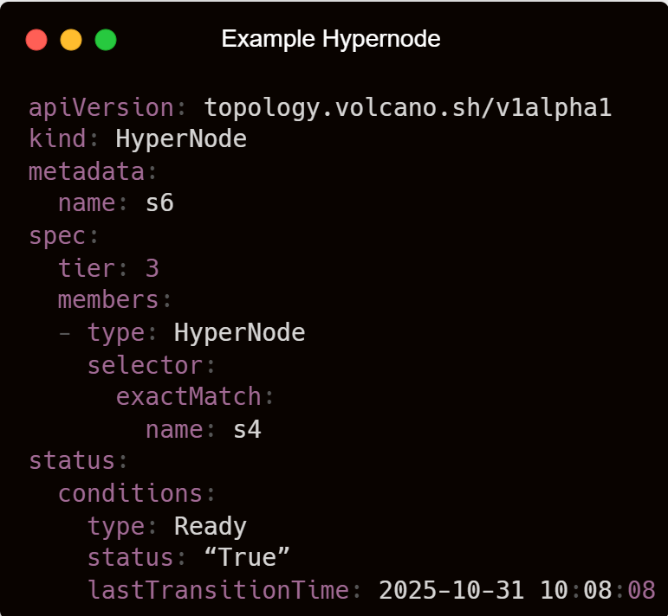
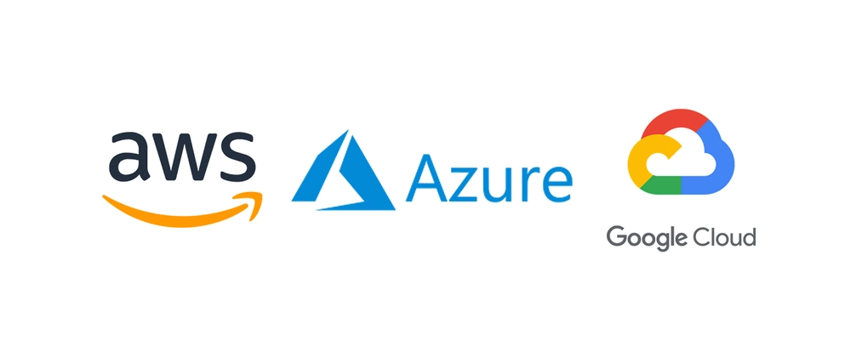
Volcano Topology Aware Scheduling： HyperNode Pluggable Auto-Discovery
AI Cluster & Cloud Environment
HyerNode API Objects
Vocano Control Plane
Discovery Manager
On-Premise：
1. NVLink Fabric Manager API
2. IB Subnet Manager (OpenSM)
3. RoCE LLDP/CDP
UFM
Discoverer
Report Network Topology
Update HyperNode Hierarchy Tree
Create
/Update
HyperNode
NodeLabels
Discoverer
HyperNode Controller
RoCE
Discoverer
Cloud：
1. Cloud Provider APIs
2. DPU/SmartNIC Telemetry
other
Discoverers
Notes:
Managing node Labels is cumbersome, so we already provide auto-discovery mechanisms on the cluster.
RoCE LLDP/CDP RDMA over Converged Ethernet (RoCE) is a network protocol which allows remote direct memory access (RDMA) over an Ethernet network Link Layer Discovery Protocol (LLDP) is a vendor-neutral, Layer 2 protocol (IEEE 802.1AB) that enables network devices to advertise their identity, capabilities, and neighbors. Cisco Discovery Protocol (CDP) is a proprietary Layer 2 network protocol that operates on Cisco devices. It enables devices to discover directly connected Cisco equipment and gather vital information about neighboring devices, facilitating network management and troubleshooting.

Slide 18
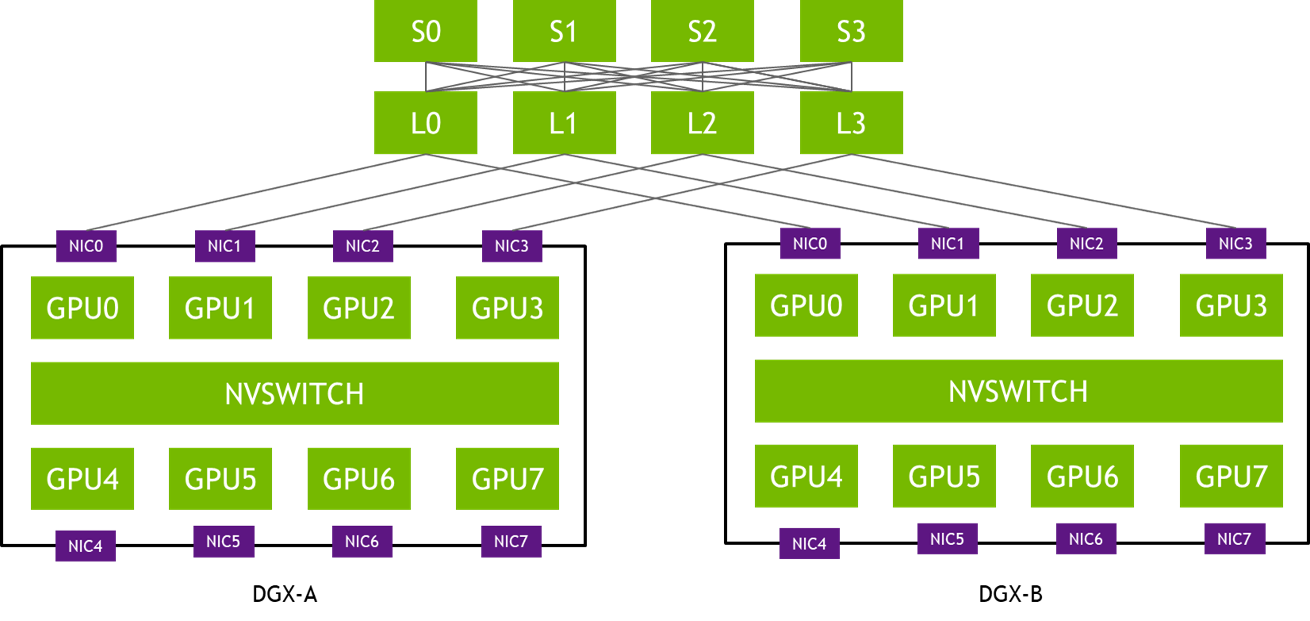
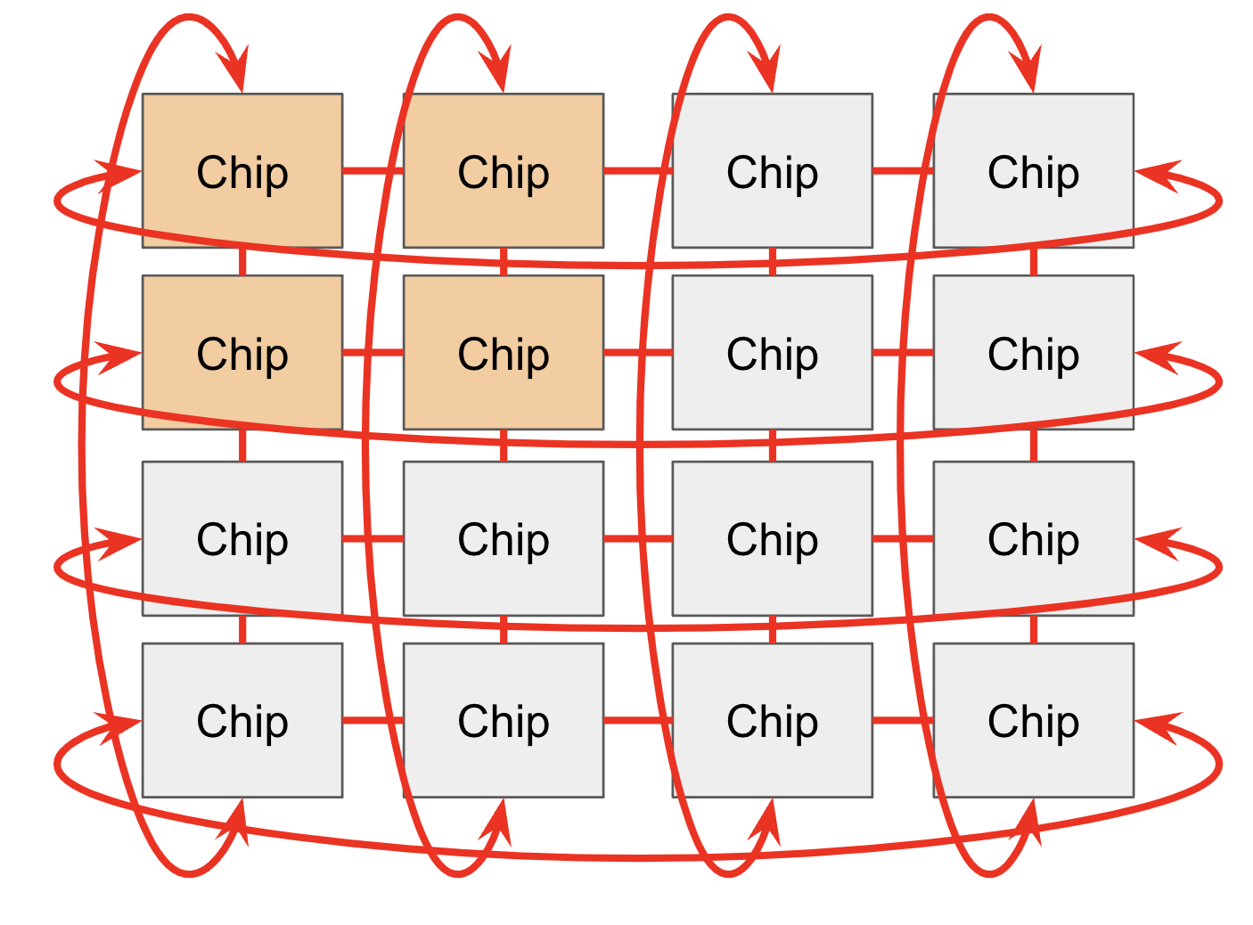
Volcano Topology Aware Scheduling: What’s Next?
Expand fields and capabilities, and collaborate with other resources (e.g. DRA) to support more networking schemes, such as multi rail, 3D torus topologies
Notes:
Currently, HyperNode only extends to support hypernodes or nodes for members, but it does not cover multi-rail architectures where GPUs are directly connected in the node through NVLink and NVSwitches, or 3D torus-like TPU networks. These can be handled by DRA, and we need to collaborate with that. We wish to expand .....
DRA handles the microscopic PCIe/NVLink alignment the internode topology handling, HyperNode provides the macroscopic network boundaries, the intranode topology.

Slide 19
Volcano Topology Aware Scheduling: What’s Next?
2. Integrate more network topology discovery tools to fully automate HyperNode and reduce the configuration pressure of admins
Standard Network Protocols:
LLDP / SNMP for generic Ethernet and RoCEv2 networks.
Open Source Providers:
NVIDIA Topograph, and DCIM (Data Center Infrastructure Management) systems.
Cloud & Fabric Managers:
Public cloud topology APIs (AWS, GCP, etc.).
Notes:
Currently Volcano has already supported Nvidia Unified Fabric Manager( UFM ) to support IB network auto discovery and label based hypernode discovery ( which is the most common solution for other schedulers), but Volcano will also look forward to integrating more network topology autodiscovery solutions

Slide 20

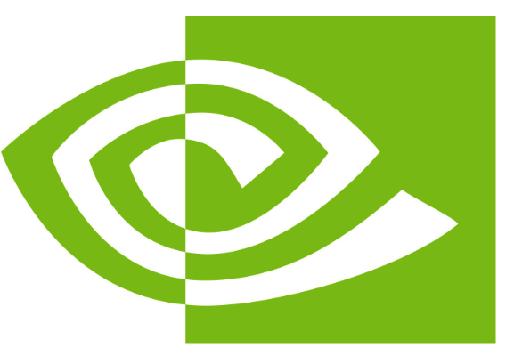


What's Next: The HyperNode Initiative
Node Label
3. Promote HyperNode as a K8s First-Class Citizen
Kueue:
Topology CRD+
Node Label
Koordinator:
ClusterNetworkTopology CRD+
Node Label
Extract HyperNode:
Decouple Volcano's HyperNode into an independent, vendor-neutral API standard.
Call for Co-creation HyperNode Initiative:
Co-create HyperNode initiatives (e.g., via CNCF TOC) to jointly define and manage HyperNode standards.
KAI Scheduler:
Topology CRD+
Node Label
HyperNode CRD
(1) Both Node Labels and auto-discovery are supported
(2) HyperNode level health monitoring, network congestion status monitoring
(3) HyperNode level bin-pack and other customize scheduling policies
Notes:
Currently, most schedulers use node labels to represent network topology and comine their own CRD to specify which label belongs to which hierarchy. This is a common practice in k8s, after all, there's no entity to represent a switch or network domain. But it has a fatal flaw: Labels are just static strings. They are stateless and flat. When we use a label like spine=switch-1, the scheduler only knows that a group of nodes share the same string. It knows absolutely nothing about the switch itself. What is the total bandwidth of switch-1? Is it currently congested? Is a port down? Labels cannot answer these questions because, in the current Kubernetes ecosystem, the switch or network domain simply does not exist as an entity.
This was fine for traditional workloads, but Large Language Model (LLM) training even inference changes everything. Modern AI clusters use highly complex network architectures, from spine-leaf to multi-Rail (Rail-Optimized) or 3D-Torus and even more complex architectures in the future.
But for hypernode
The reasons are as follows:
First: Stateful and Dynamic Scheduling.
Because HyperNode is an object, it has a Status field. We can continuously inject real-time telemetry data—like available bandwidth, packet loss rates, or link health—directly into the HyperNode. The scheduler can finally make decisions based on real-time network load.
Second: Native Support for Complex Topologies.
HyperNodes can easily express Many-to-Many relationships. Is can extend and support more complex network architecture, not just includes spine-leaf architectures
Third: Unified Hardware-Network Co-design.
In the long run, as we integrate other resources like DRA, HyperNode provides the macroscopic network boundaries, while DRA handles the microscopic PCIe/NVLink alignment. Together, they form the ultimate scheduling engine for next-generation AI infrastructure.
So We wish to promote hypernode as a kubernets first-class citizen, we will
Extract HyperNode:
Decouple Volcano's HyperNode into an independent, vendor-neutral API standard.
Call for Co-creation HyperNode Initiative
Co-create HyperNode initiatives (e.g., via CNCF TOC) to jointly define and manage HyperNode standards.

Slide 21
Kthena: Kubernetes-Native LLM Serving Platform
Notes:
Hi Im Zicong Chen, You can also call me Jesse, I’d like to introduce to you the latest update for the 3 volcano sub-project

Slide 22
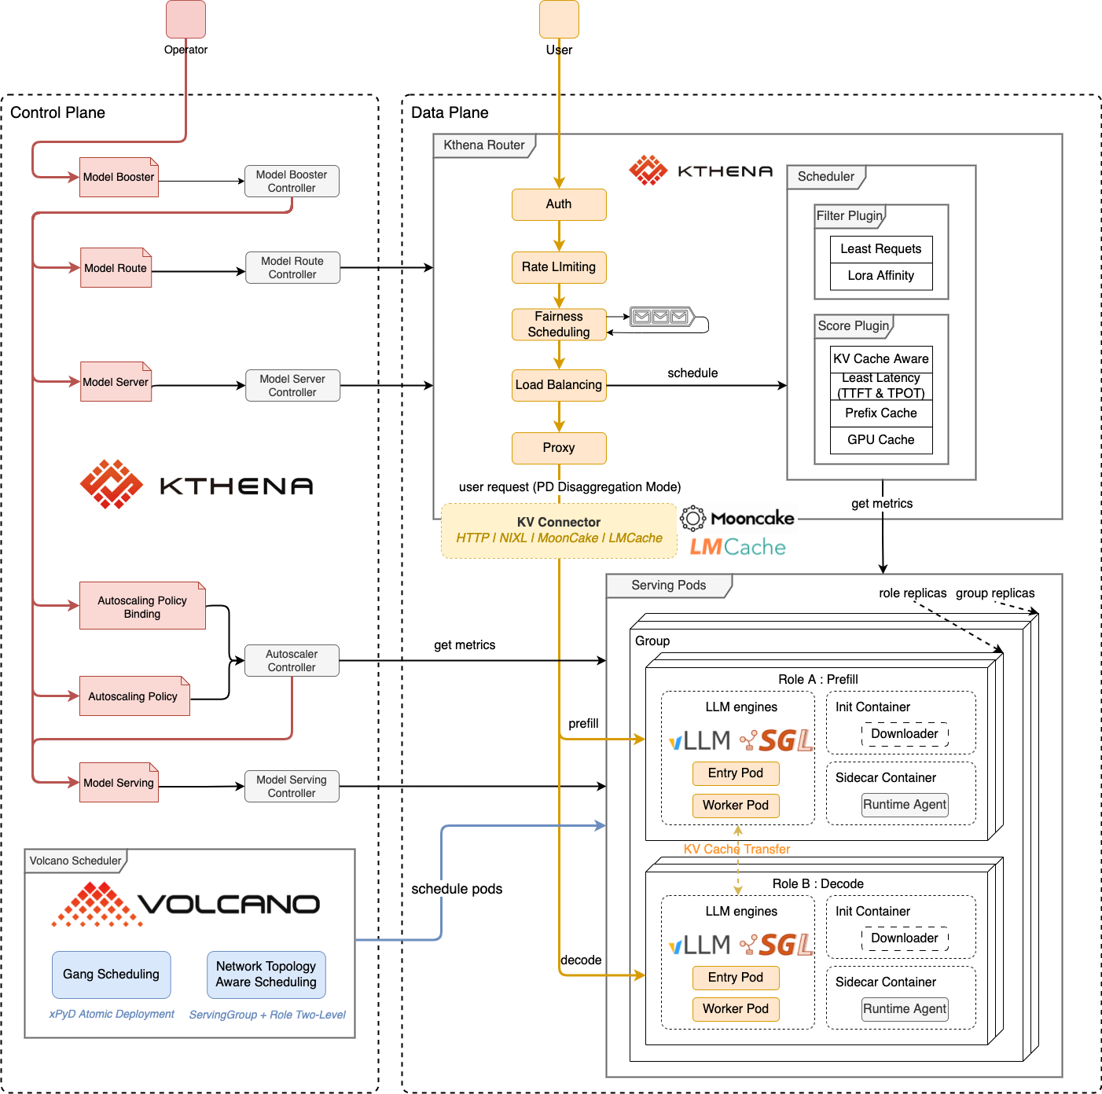
Kthena: Kubernetes-Native LLM Serving Platform
1. Declarative Control Plane
Supports vLLM, SGLang, Triton, TorchServe, MindIE (Support both standard and prefill-decode disaggregated)
Autoscaling on token throughput, queue depth, CPU/GPU, and budget
Rolling updates, canary, failover, dynamic LoRA management
2. Intelligent Data Plane
KV-cache, prefix-cache, PD-group aware routing via Redis
Pluggable KV connectors (LMCache, NIXL, Mooncake) for PD disaggregation
Token rate limiting, weighted traffic
3. Volcano-Native Scheduling
Gang scheduling for atomic xPyD deployment
Two-level network topology-aware scheduling (ServingGroup and Role)
Notes:
It supports wide ecosystem, it supports vLLM, sglang... Both support standard and prefiil-decode disaggrated mode, it can autoscale on token throughput, budget, request queue depth, it also has a intelligent router, which can do kv-cache, prefix-cache aware routing, it has a lot of pluggable kv conncetors suppported, such as LMCache, Mooncake and on, it can integrate natively with volcano, to do gang scheduling for xPyD deployment and topology aware scheduling

Slide 23
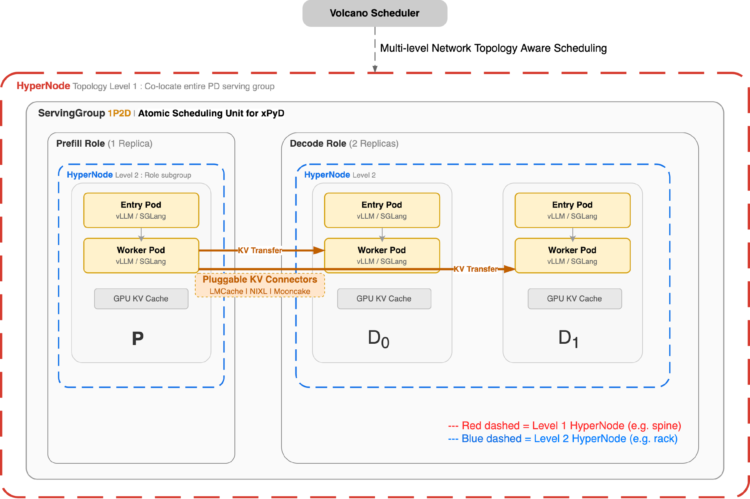
Kthena: Native Prefill-Decode Disaggregation
ServingGroup as atomic scheduling unit for xPyD (1P1D, 1P3D, etc.)
Gang Scheduling: all pods in a PD group scheduled together or not at all
Multi-level network topology-aware scheduling:
ServingGroup level: co-locate entire PD
group in same HyperNode
Role level: co-locate Entry + Worker within
each Prefill/Decode role
Pluggable KV Connectors (LMCache, NIXL, Mooncake) for KV cache transfer between P and D
Notes:
Kthena natively supports Prefill-Decode disaggregation for LLM serving.
Since Prefill and Decode have very different resource and runtime characteristics. Prefill is compute-heavy and generates KV cache, while Decode is more latency-sensitive and continuously consumes that KV cache. Treating them as a single flat workload is inefficient.
What Volcano provides here is a scheduling model that understands this structure natively.
A ServingGroup becomes the atomic scheduling unit, so all related pods can be scheduled together with gang semantics. On top of that, Volcano supports multi-level network topology-aware scheduling, which lets us co-locate the full PD group at one level, and further optimize placement inside each role at a finer level. E.g., prefill and decode have different topology aware requirement. And even Prefill and Decode roles can do auto scale seperately. And it already support lots of pluggable kv conncectors

Slide 24
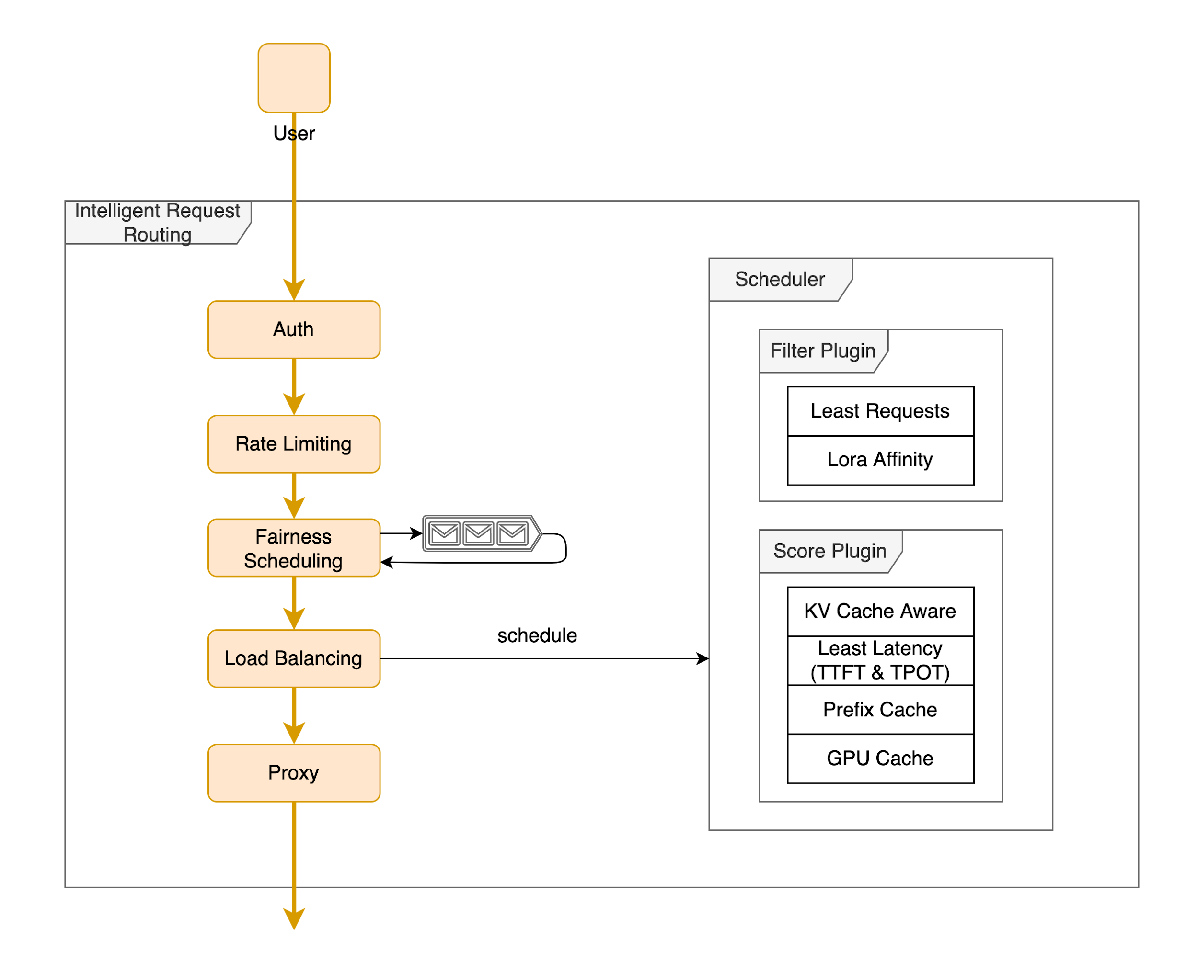
Kthena Router: LLM-Native Intelligent Routing
Smart Pluggable Routing Engine
prefix-cache — route to pod with matching prompt prefix
kvcache-aware — Redis-based distributed KV block matching
least-request — avoid pods with long queues
least-latency — prefer lower TTFT / TPOT
lora-affinity — route to LoRA-loaded pod
gpu-usage — prefer free GPU KV cache
Token-Level Traffic Management
Token-based rate limiting (input + output, local + global Redis)
Per-user fairness on historical token usage
Weighted splitting for canary / A-B / multi-LoRA
Native PD Disaggregation Routing
PD-group aware request splitting (Prefill then Decode)
KV Connectors: HTTP / NIXL / LMCache / Mooncake
Independent scoring per phase, automatic KV transfer
Notes:
Kthena Router is not a traditional load balancer. It is an LLM-native routing engine designed specifically for LLM serving workloads.
Instead of routing requests only by round-robin or simple queue length, it can make decisions based on model-serving semantics.
For example, it can route by prompt prefix, KV cache locality, LoRA affinity, queue status. It also introduces token-level traffic management, including token-based rate limiting, per-user fairness, and weighted routing for canary or multi-LoRA scenarios.
Most importantly, it works natively with Prefill-Decode disaggregation. The router understands that Prefill and Decode are different stages with different optimization goals, so it can split and score requests accordingly, while coordinating KV cache transfer between phases.
So the key message here is that Kthena Router brings application-level intelligence into the serving path, and that is essential for efficient large-scale LLM serving.

Slide 25
AgentCube: A Kubernetes-Native Platform for AI Agent Workloads

Slide 26
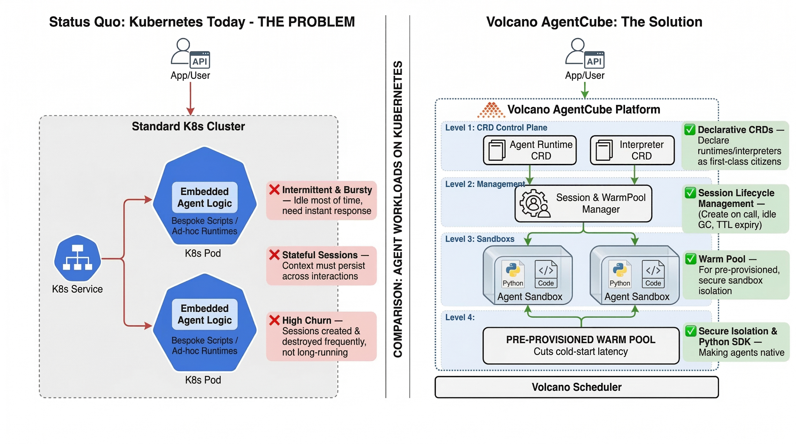
AgentCube: A Kubernetes-Native Platform for AI Agent Workloads
Notes:
On the left is the status quo in standard Kubernetes.
If you build AI agents directly on top of regular pods, the agent logic is embedded inside each workload. That creates several problems: startup latency is high, session state is hard to preserve across interactions, and frequent create-and-destroy cycles introduce significant overhead.
On the right is Volcano AgentCube.
Instead of treating every agent request as a brand-new pod lifecycle, AgentCube introduces a layered runtime model. It has a session and warm-pool manager to preserve context, and pre-provisioned sandboxes to achieve much faster startup.

Slide 27
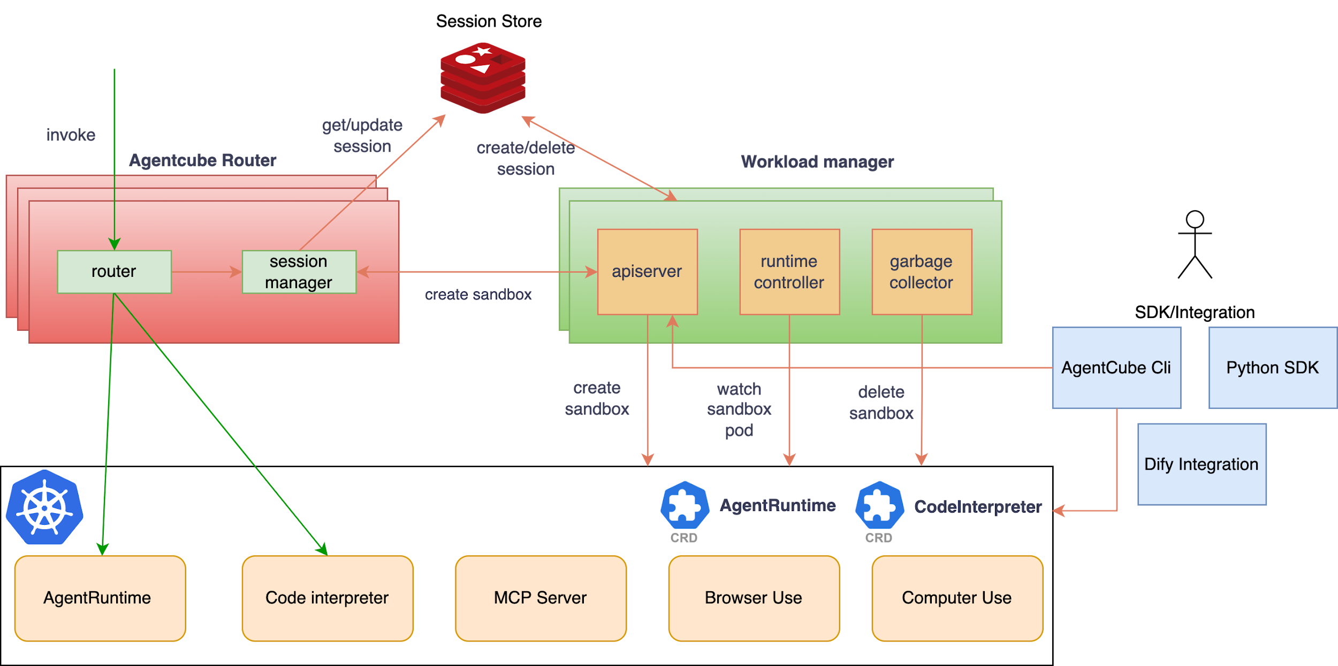
AgentCube: A Kubernetes-Native Platform for AI Agent Workloads
Session-aware routing and lifecycle management
Warm pools for reusable, fast-starting sandboxes
Out-of-the-box SDKs, CLI, and extensible integrations
Notes:
AgentCube builds on sigs/sandbox today, and will introduce native agent primitives and broader integrations with frameworks such as Dify and more frameworks

Slide 28
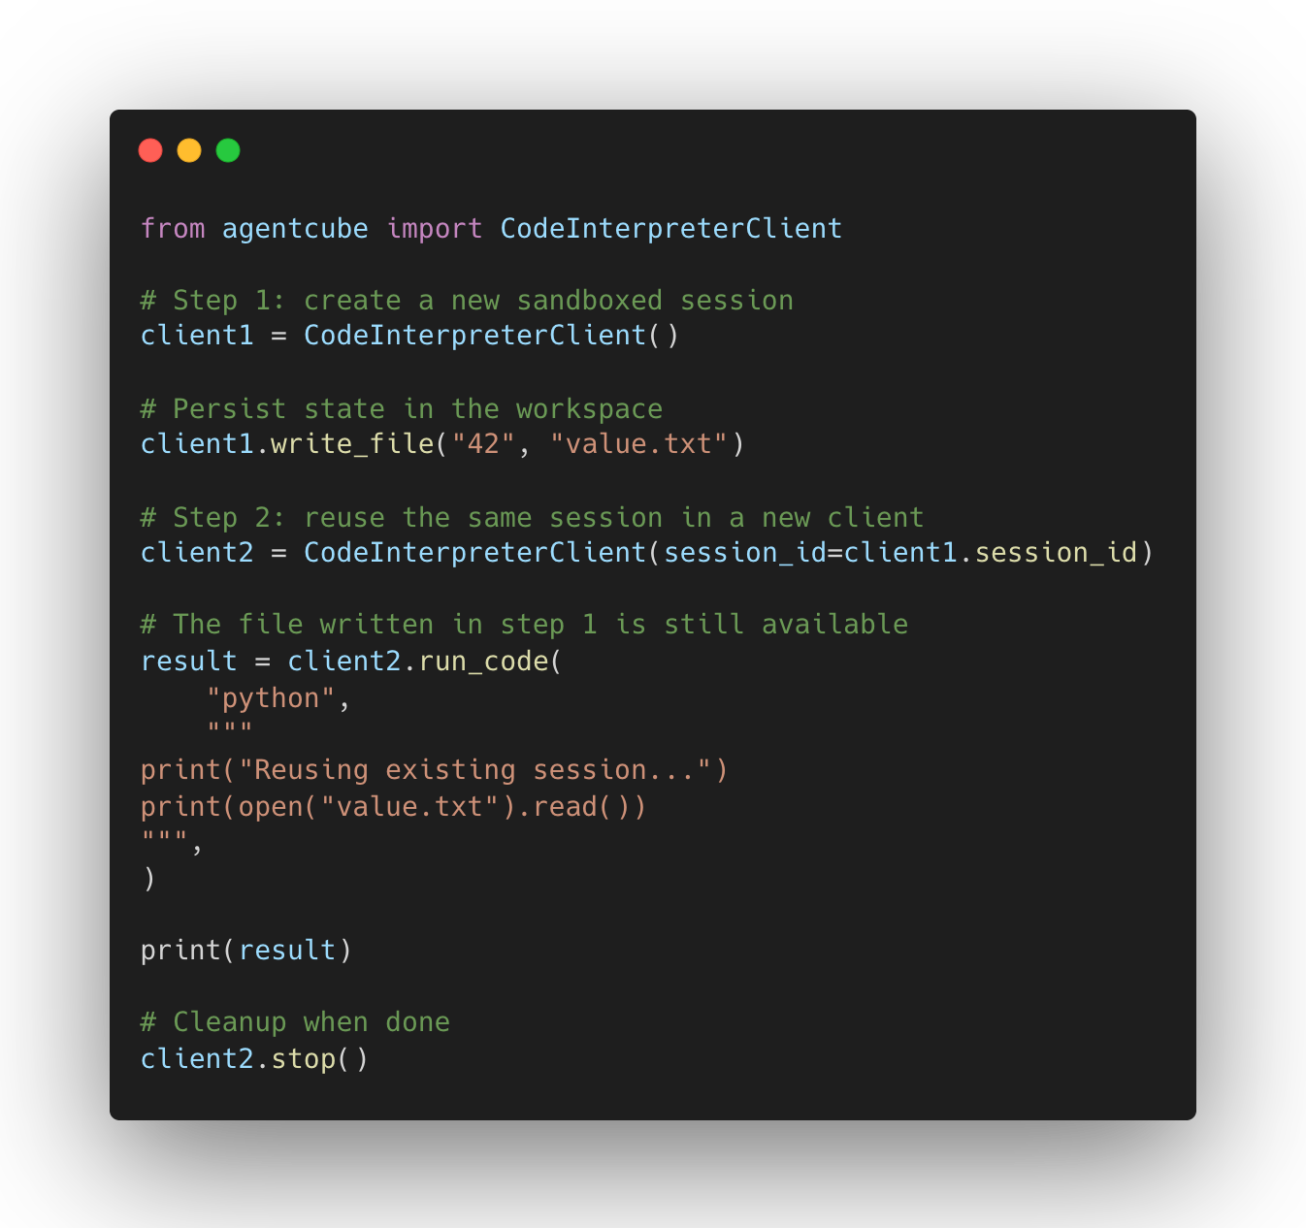
AgentCube: Out-of-the-Box SDK
Getting Started:
https://github.com/volcano-sh/agentcube/blob/main/docs/getting-started.md
Python SDK Example:
https://github.com/volcano-sh/agentcube/blob/main/sdk-python/examples/basic_usage.py
Notes:
You can directly use the python SDK to create reusable sandboxes, and send the prompt to the sandbox to handle, and if you’re willing to reuse the previous sandbox, the sdk provides you a way that you can reuse the previous session id and send to the same sandbox, it will hold the warm pool for the agents

Slide 29
Volcano Global: What’s new?

Slide 30
Volcano Global: What’s new?
Feature 1: HyperJob
Multi-cluster Job Splitting for Large-scale AI Training
Feature 2: Data Dependency Aware Scheduling
Data-Aware Placement for Compute-Storage Disaggregation
Notes:
Volcano global is a project can do multi-cluster dispatching, it currently build on karmada

Slide 31
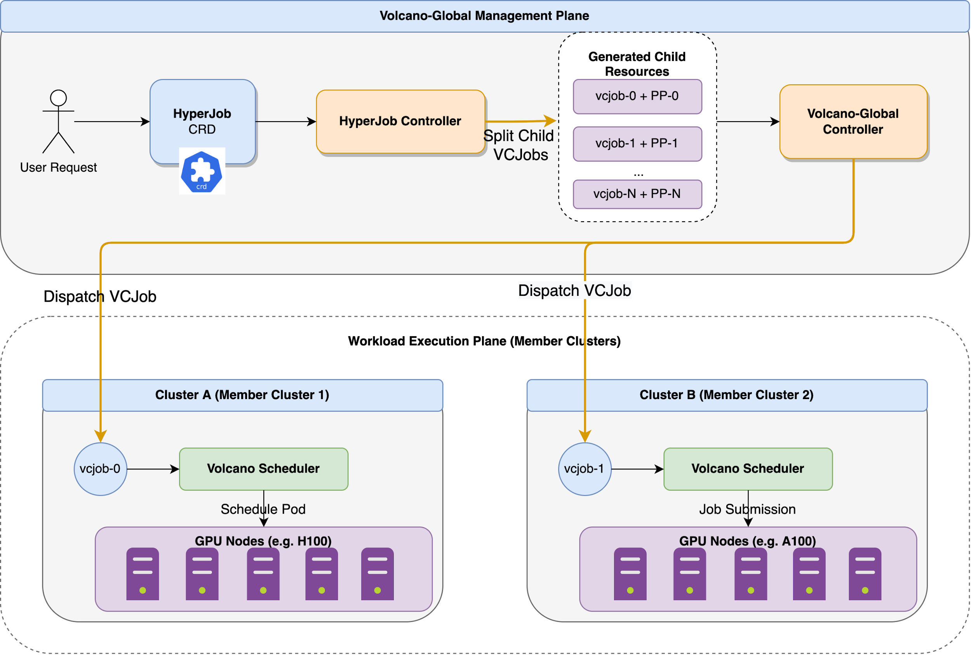
1. HyperJob for Multi-cluster Job Splitting
Break Scale Limits: Train massive LLMs requiring thousands of GPUs that exceed a single cluster's capacity.
Embrace Heterogeneity: Seamlessly split and coordinate training tasks across clusters with different hardware (e.g., A100 in Cluster A, Ascend in Cluster B).
Unified Experience: Submit one job, get one aggregated status. No manual distribution or cross-cluster coordination required.
Notes:
Why do we need HyperJob? Because LLMs are getting too big for one cluster. And event clusters are heterogenous. HyperJob automatically splits your massive training job across multiple heterogeneous clusters, while giving you a single, unified view of the entire process.

Slide 32
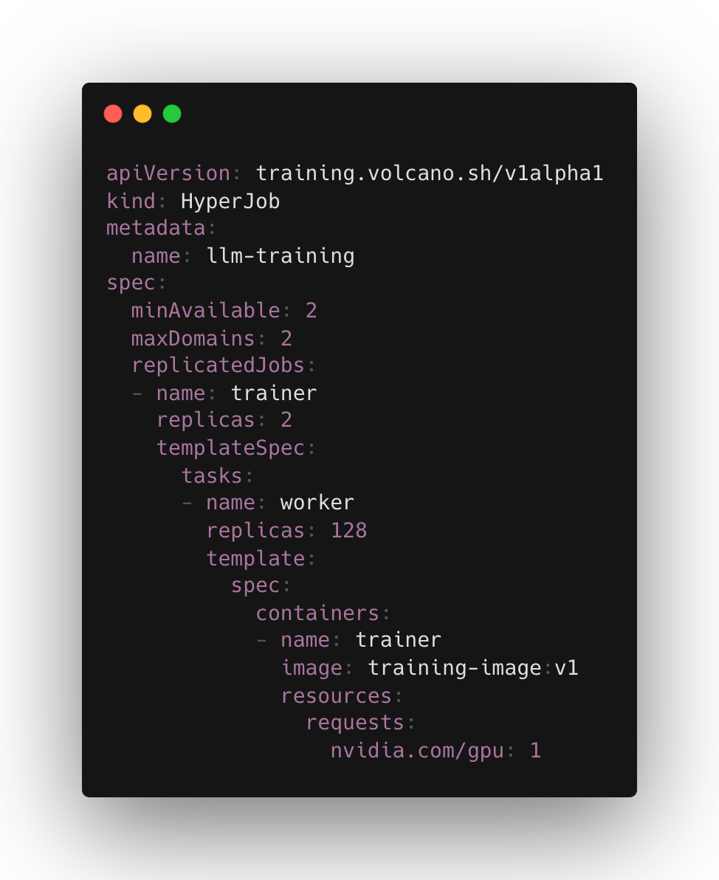
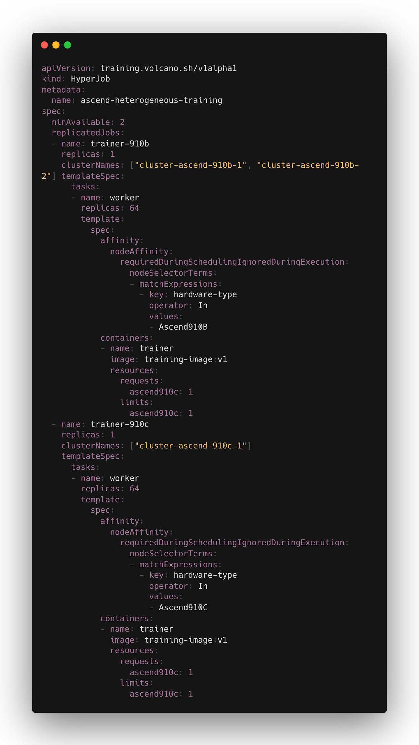
HyperJob Use Case
Case 1: Large-scale Training Job Splitting
Case 2:
Heterogeneous Clusters

Slide 33
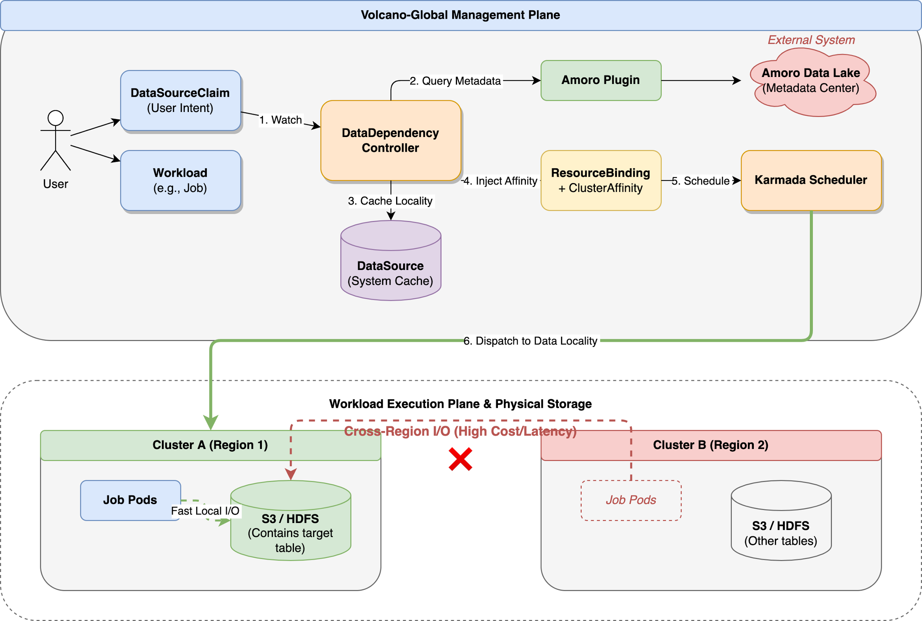
2. Data Dependency Aware Scheduling
Pluggable Integration: Connects with external Data Lakes (e.g., Amoro, Hive, S3) to discover physical data locality.
Zero-Touch Placement: Automatically injects affinity rules to force workloads to the cluster closest to the target data.
Notes:
Volcano Global extends scheduling beyond a single cluster and makes data locality a first-class decision factor.
In many real-world AI and analytics workloads, moving data is often more expensive than moving compute. If a job is scheduled in the wrong cluster, it may trigger cross-region or cross-zone data access, which significantly increases both latency and cost.
What Volcano Global does here is connect to external data systems through pluggable integrations. It can query metadata from systems such as data lakes or catalog services, discover where the target data physically resides, and cache that locality information.
Based on this, the scheduler can automatically inject affinity into placement decisions, so workloads are dispatched to the cluster closest to the data.

Slide 34











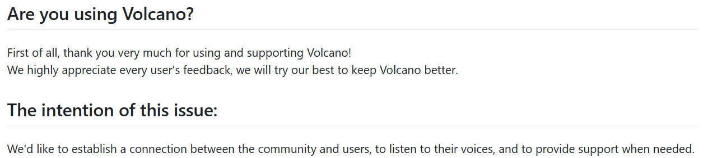




















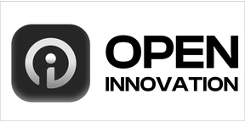
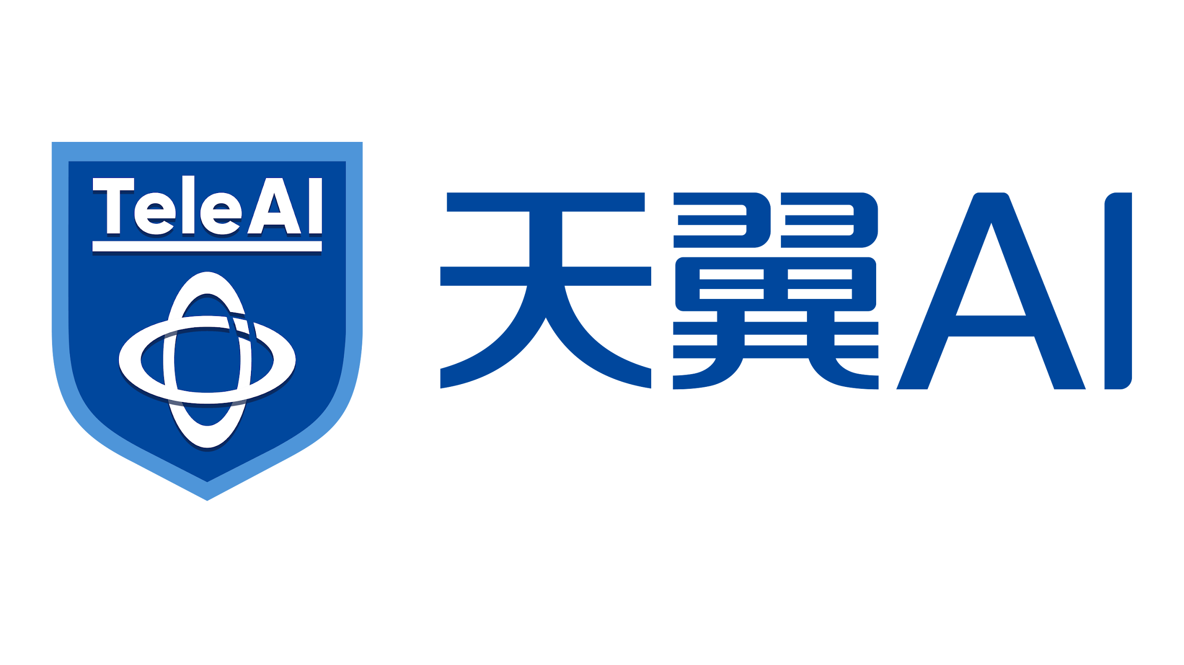



Resources and Call for Contribution
Call For Use Case:
https://github.com/volcano-sh/volcano/issues/3855
Call For Contribution:
https://github.com/volcano-sh/volcano/blob/master/contribute.md
community user
60+ Production

Slide 35
Q&A

Slide 36
Thank you!

